Slide 1


Capstone Project Battle of the Neighborhoods
Analysis for investing in Toronto Food Industry
Esteban Hernan Elia

Slide 2
Introduction
Toronto is also a world leader in recognizing the role of cities in using food as a lever to promote health, well -being and sustainability
03
The food and beverage cluster is the second largest employment sector in Toronto
02
Toronto, the provincial capital of Ontario, with a population of over 2.7MM, is one of Canada biggest cities
01

Slide 3
The Problem
The current work is an exploratory analysis for a stakeholder seeking to permanently move to Canada and start a business in the Food Industry. It Analyzes the commercial areas of Toronto and the density of the several business in them, with the aim of getting familiar with the commercial landscape needed for accurately pinpoint the location of this future endeavor.

Slide 4
Data Gathering and Metodology
Using the Forsquare API to gather Food related venues.
Ranking the findings for the top 5 venues.
Using K-Means to cluster the resulting data into commercial areas.
Finding what areas are more suitable for new venues
Analyze the data in each areas to pinpoint specific opportunities.

Slide 5
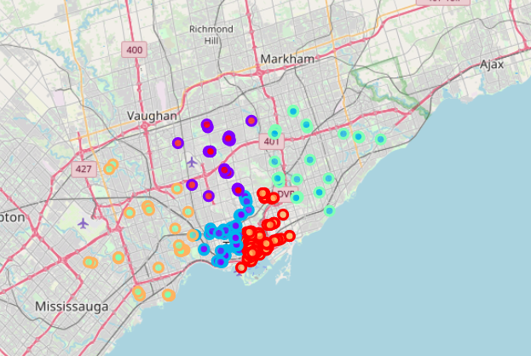
Areas

Slide 6
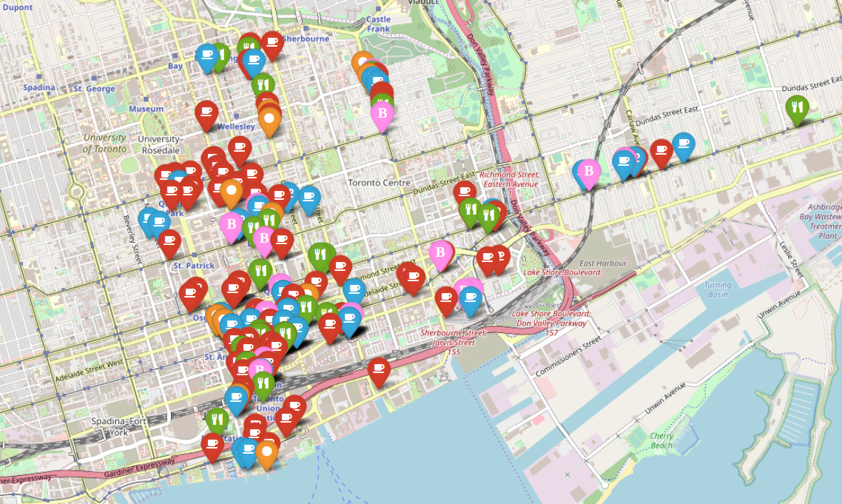
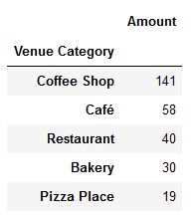
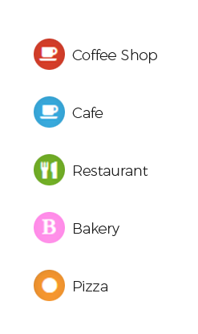
Red Area (Downtown)

Slide 7
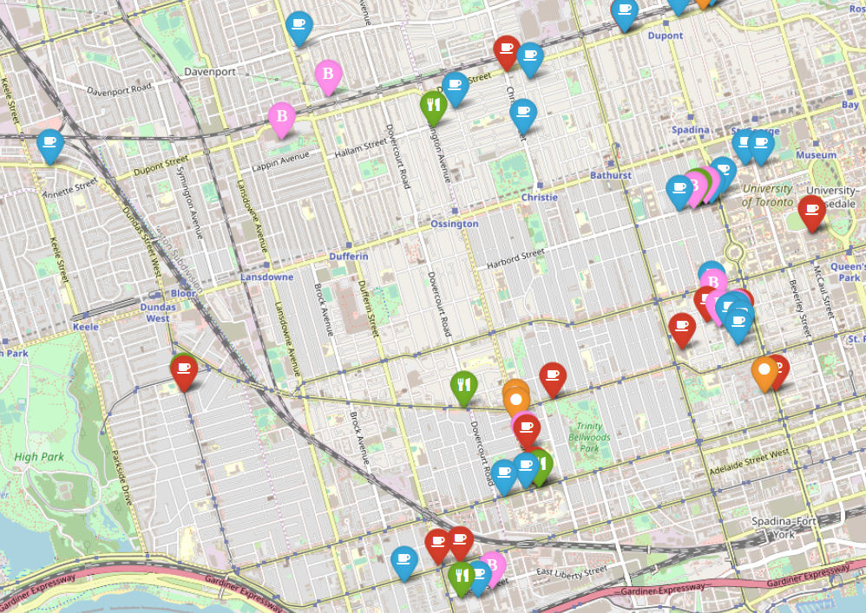
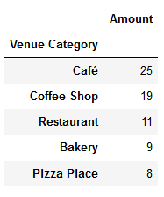
Blue Area (Near Downtown)

Slide 8
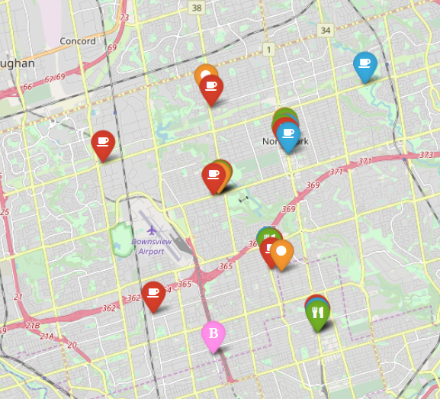
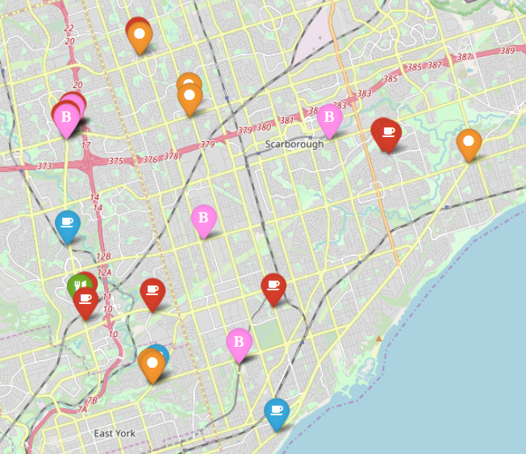
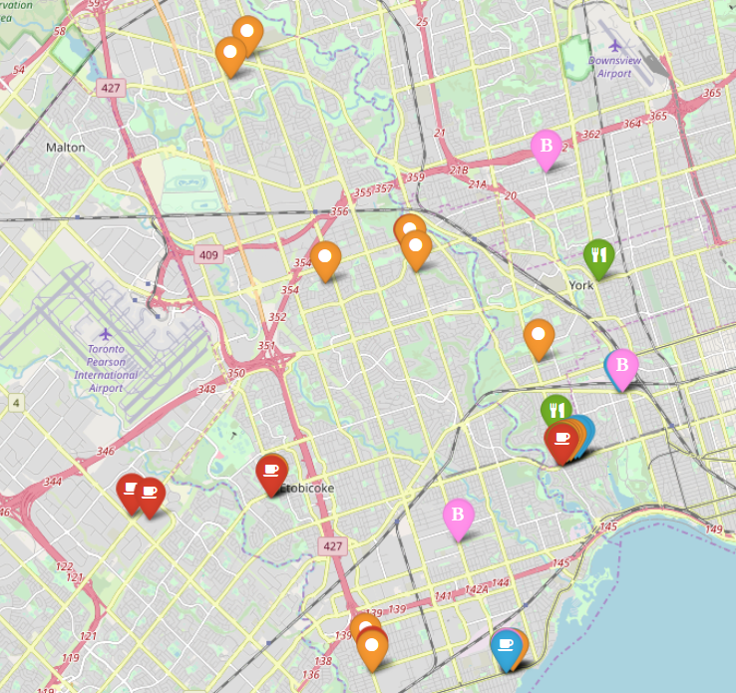
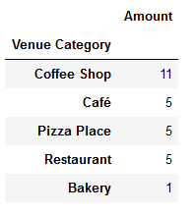
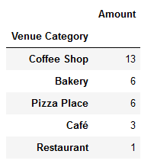
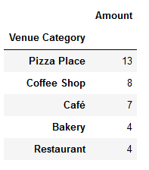
The suburbs
Given the low density of venues, we should disregard this areas for this analysis, since we cant conclude much other than the venues located are randomly spaced over the area

Slide 9
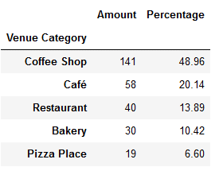
Downtown(analysis)
The majority of venues are Cafes and Coffee Stores (70%).
Very few Pizza Places in comparison (6% of the tota) venues).
This could be an opportunity since the area is as dense as it gets for food where you have some restaurants but very few Pizza Places in comparison.

Slide 10
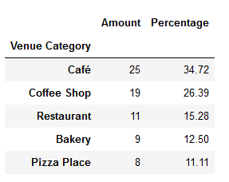
Blue Area (Analysis)
This area could be an opportunity depending how close to downtown you could get a location,
Pizza places for this area are also pretty far away from the downtown area
This area could be also an opportunity if the stakeholders can find a good location near downtown (bordering the left side of the blue area map)

Slide 11
Conclusions
We can conclude that there are some opportunities to invest in a venue around the Red Downtown area, specifically in the Pizza Place category, since there’s seems to be way fewer offers than a dense area like the one we analyze should offer, only 6% of the total venues, where Cafes and Coffee Stores sum up to 70%.
There could be similar opportunities on the Blue Area if the stakeholders could find a location closer to the downtown area, because the vast majority of the pizza places in this area are far away, even though the percentages are closer together for the remaining categories excluding Coffee Store and Café.

